Slide 1
From LTO project to AM in the long term
2024-06-06
Joakim Thulin, Martin Hägglund
Forsmarks NPP
Vattenfall AB

Slide 2
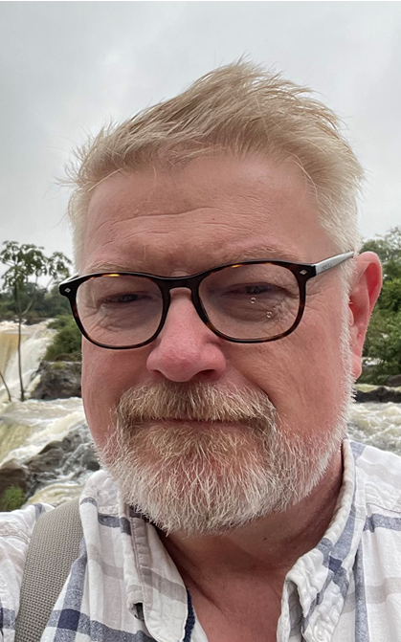
Presented by
Joakim Thulin
- Plant specialist,
Ageing Mgmt
- Mech. engineer
- 29 years in the
nuc. Industry
- Currently no beard
Martin Hägglund
- Manager system health
Electrical systems
- Marine engineer
- 26 years experience in
nuclear industry

Slide 3
Forsmark NPP! Sweden's largest electricity producer
Every sixth lamp in Sweden is lit by Forsmark
24 TWh – electricity for just over three cities the size of Stockholm

Slide 4
High level of supply through the ages
F3 - LTO
TWh
F2-LTO
F1- LTO
Forsmark 1
Forsmark 2
Forsmark 3
SKIFS2004:1 5kap 3§
SALTO
Pre - SALTO
Pre - SALTO
Preparation for LTO

Slide 5
Our winding road of LTO Preparation
Our first step in the LTO preparations 2006-2012 to implement living aging management partly failed
- Why? We did only the central part of the living aging management of the PDCA-circle
“Understand and document aging of SSC”
- Around 100 aging analyses were created and stored on the shelf
- Only one department worked with the Issues – no cross functional work over the departments
Our second step 2012 was to set up a company – instruction for aging
- “you should do this, and report to them?!
- Do you think that worked?
In our third step we moved the responsibility for aging to the new” engineering department
- We formed an LTO-project
- All departments were involved but the actual work was mainly preformed by consultants mainly
- No physical farmwork was created to work together - The organization set-up should be enough?
the following planed SALTO 2019 was change to a Pre-SALTO. Way?
Mainly because the shortcomings in the “living aging management”

Slide 6
The transition to a living ageing management
Forsmark has divided responsibilities and tasks within the organisation as follows:
Operation operates the plant
Engineering is the asset and design owner
Maintenance maintains the plant
On top of this is Engineering responsible for coordination of ageing management activities
For a living ageing management to work and improve, at least four conditions must be met:
There must be a tight connection between the designing and analysing part and the measuring, checking and monitoring part of the organisation.
For the above connection to work, there must be an effective knowledge management
Ageing management must adapt as the plant evolves through design changes
Ageing management must be aware and adapt to new ageing effects

Slide 7
Solution with implementation
A common way to implement organisational entities for AM is to create a line organisation for it within the company.
This was not an option in Forsmark.
As AM is set as a company wide task, that is to be coordinated from Engineering, a different approach was necessary
Formations named Teknikområdesgrupper (TOG’s) was established (in English: Technical Domain Groups)
4 groups were established, one each from the domains Mechanical, Electrical/I&C, Ventilation and Civil.
Each group have representatives from operational maintenance, design departments and is governed by a manager from System Health.
The 4 groups are supervised by a coordinating group, the TOG chairmen are members of the supervising group.
A common procedure sets out guidelines for the TOG’s and the supervising group.

Slide 8
TOG’s in daily use
The TOG’s with supervising group has operated since 2021 and has now matured into something that can operate until the plant is shutdown.
Engineering representative bring the line responsibility of scope setting and AMR.
Maintenance representative bring the line responsibility of evaluating most plant events and implementation of AMP.
The chairman request evaluation of internal and external OpEx.
The chairman keeps track in the plant CAP of recommendations from both the AMP-side and the AMR-side.
Because of the split of AM-responsibilities within Maintenance and Engineering, Forsmark aim to make both departments get a sense of ownership for AM.
The formation also provides a foundation for knowledge transfer from maintenance to engineering and vice versa.
Cross discipline functions, such as environmental qualification, water chemistry, obsolescence and surveillance, have identified programme owners and are called into service on an ad-hoc basis to the TOG’s.

Slide 9
Programme effectiveness
TOG’s do supervise AMP effectiveness with IAEA nine attributes for effective ageing programmes (SSG-48 table 2), but also with a global indicator.
Globally, the target is that a safety function must not be unavailable when it is needed, in this context due to ageing effects.
Events in the work order system have a specific code when the event lead to loss or degradation of functionality. In Forsmark this code is named AUH.
Ideally the acceptance criteria for such an indicator is zero, but in practice, a few of those are impossible to avoid.
Every quarter all AUH are evaluated, those that are not root caused by ageing or are not in-scope for AM are screened off.
Typically, AUH-events appear during outage; to iron out such dependencies, the evaluation is done on a rolling 12-month period.
This evaluation is part of Forsmark set of indicators and is the only one dedicated for ageing.

Slide 10
AUH in Forsmark
Rolling 12-month schedule
Only relevant ageing AUH
Unit 2 heavy
Quarterly, per domain. Outage season is apparent
I&C-heavy
Other = bad coding / not ageing / not in-scope
Active and passive SSCs

Slide 11
Challenges and areas for improvement
The feedback from the AMP-side is not yet effective. It is a challenge establishing ways to monitor programme effectiveness.
Indicators on programme effectiveness need to be established on a commodity level, to pinpoint weak areas.
The awareness that ageing management in the long term need dedicated resources, to keep scope and AMR up to date, to be able to evaluate events and perform trend analysis and prepare mitigating or preventing measures in the plant, to avoid recurrence.
Next step is LTE, beyond 60 years…

Slide 12
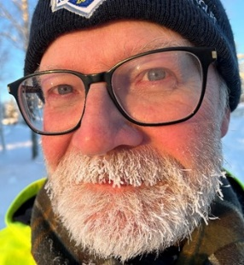
Contact Details
Martin Hägglund
Manager system engineer electrical systems
Forsmarks Kraftgrupp AB
Martin.hagglund2@vattenfall.com
+46702581940
Joakim Thulin
Specialist ageing management
Forsmarks Kraftgrupp AB
joakim.thulin@vattenfall.com
+46702868519

